Slide 1



Harnessing the power and potential of human cultural evolution
Christine A. Caldwell
University of Stirling

Slide 2
Overview
Human cumulative culture: a brief introduction
Theoretical and practical/pragmatic motivations for understanding cumulative culture
Experimental approaches to studying cumulative culture
  Capturing cumulative culture in the laboratory
    Cumulative benefits from cumulative experience, despite participant turnover
  Which kinds of social information permit cumulative culture?
  Under what conditions does intentional information-sharing facilitate cumulative culture?
Conclusions: The value of (cultural) population-level thinking and experimentation

Slide 3
A little background context to the motivation behind much of my research…

Slide 4
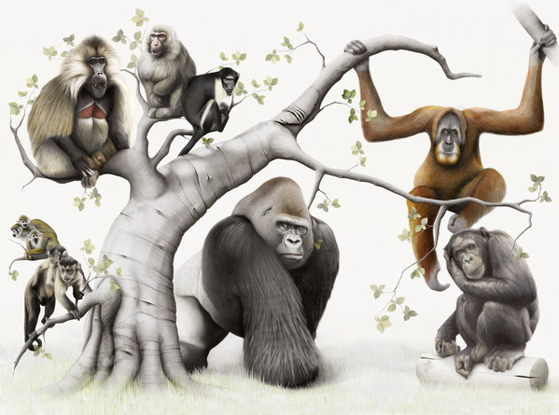
Culturally learned traits are responsible for much of what distinguishes humans from other primates.

Slide 5
Can differences in the cultural evolutionary processes observed in humans, compared with other species, be explained in terms of the cognitive mechanisms involved?

Slide 6
What are those differences?
There is general agreement that human cultural evolution often shows characteristic patterns of consistent directional change over multiple generations of transmission.
Specifically, the direction of change represents increasing benefits (i.e. some improvement in utility, e.g. through increased functionality or efficiency).
This is usually referred to as cumulative cultural evolution, or just cumulative culture.

Slide 7
What is cumulative cultural evolution?
(Mesoudi & Thornton, 2018)
“Core criteria” defined as:
  A change in behaviour (or product of behaviour, such as an artefact), typically due to asocial learning, followed by
  the transfer via social learning of that novel or modified behaviour to other individuals or groups, where
  the learned behaviour causes an improvement in performance, which is a proxy of genetic and/or cultural fitness, with
  the previous three steps repeated in a manner that generates sequential improvement over time.

Slide 8





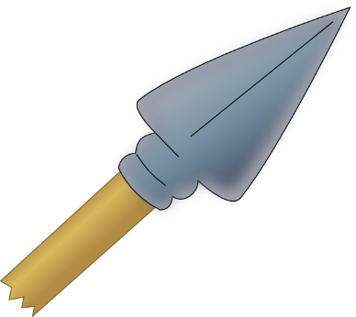
Examples include…
Food preparation techniques
Garment construction
Hunting skills and tools
Notes:
Researchers interested in cumulative culture tend to focus on the kind of cultural evolution that accounts for the existence of adaptive traits in humans which have built up over many generations of transmission, in particular when those traits would have been either unlikely or impossible for individuals to learn without exposure to social information. This includes, for example, food preparation techniques (including cooking), methods of constructing clothes, and the creation and use of projectiles for hunting. What unites cases that are universally regarded as compelling examples of cumulative culture is not just the utility of the traits but also the extreme improbability of independent discovery. Thus, acquisition that depends on exposure to social information, and a lengthy, trans-generational history of trait development, may often be identified as archetypal characteristics of cumulative culture not because these are necessary or sufficient criteria in and of themselves, but because they are indicative of traits that would be extremely costly to acquire through asocial learning alone.

Slide 9
The Value of Cumulative Culture
Human cultural evolution appears to provide a powerful source of adaptive traits, unparalleled in other species.
Cumulative cultural evolution allows us to benefit from others’ accumulated exploration efforts in the absence of direct personal experience.

Slide 10
The Down Side
Cultural evolution does not always result in cumulative benefits…

Slide 11
“Humans are an oddly contradictory species. On the one hand, we are spectacularly adaptable. Our species occupies a wider range of habitats, utilizes a much greater range of resources, and lives in a more diverse range of social systems than any other animal species. … At the same time, humans engage in spectacularly maladaptive behaviors. We take dangerous drugs, risk life and limb to reach mountain summits, restrict our fertility to attain economic and professional success, and march off to war to defend God or liberty or nation. How can it be that we are both so clever and so stupid?”
Boyd, R. (2007). Cultural Adaptation and Maladaptation: Of Kayaks and Commissars.

Slide 12
Detrimental Outcomes of Cultural Evolution
Regardless of whether or not we agree that it is “stupid” to adopt behaviours that are not directly in the interests of our genes, cultural transmission can also result in the diffusion of traits that have unambiguously deleterious consequences, simply because these are not obvious to us at the time of trait adoption.
Notes:
This can happen due to, e.g.
Short-term value provides a poor indication of longer term consequences (e.g. kuru) – these can then spread like wildfire before longer term consequences are understood.
Multimodal fitness landscape - Reduced learning costs of social learning relative to unconstrained exploration can mean populations get trapped at local optima even and miss global optima.
Individual-level consequences may conflict with group-level consequences
Transmissibility may influence what spreads at the cost of effectiveness.

Slide 13
Fatal Disease Transmission as a Consequence of a Cultural Practice (Lindenbaum, 1979; Durham, 1982)
Kuru (a fatal neurodegenerative disorder) killed many members of the Fore tribe of Papua New Guinea (particularly adult women), but was undocumented outside of this limited area.
The disease was being transmitted by the tribe’s practice of ritual cannibalism which became the customary means of disposal of deceased kin in the early 1900s, with female relatives supplementing their diet with human flesh and brain tissue.

Slide 14
Fatal Disease Transmission as a Consequence of a Cultural Practice (Lindenbaum, 1979; Durham, 1982)
By mid-century this cultural trait still had a high rate of transmission, despite its deleterious consequences.
This continued in part due to the Fore’s belief in sorcery as the cause of the disease, and in part due to the short-term dietary benefits of cannibalism.

Slide 15
And even when information is highly beneficial, it is rarely transmitted with perfect fidelity.
Experimental studies of “serial reproduction” show how rapidly information can degrade with transmission…

Slide 16




Material presented to first participant:
“John and Nancy entered the restaurant and were shown to a table by the waitress. They sat down on the chairs and placed napkins on their laps. Then they looked at the menu and decided what food to have. They signalled to the waitress and told her their order, which the waitress wrote down. John and Nancy drank wine and talked until their food arrived. They ate the main course, then they had dessert. John asked for the bill, and the waitress brought it over. John took out his wallet and left money, as well as a tip. Then they both stood up and went to the cloakroom to fetch their coats. John and Nancy put on their coats and walked outside.”
Fourth generation recall:
“Ian woke up and ate breakfast. Nancy went to the supermarket for shopping. Afterwards they both met up and had lunch.”
e.g. Mesoudi & Whiten (2004) J Cogn Culture

Slide 17
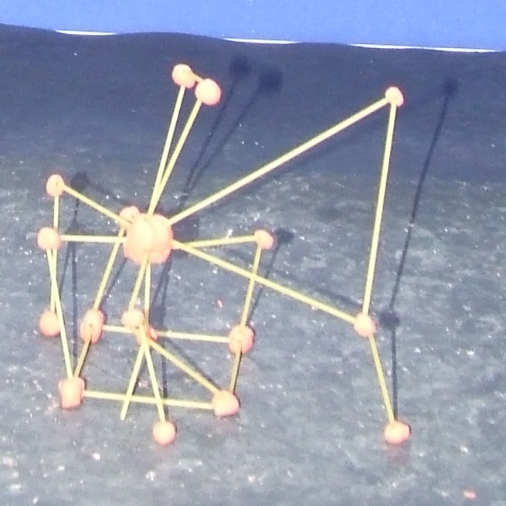
Seed structure:

Slide 18
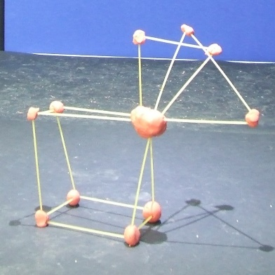
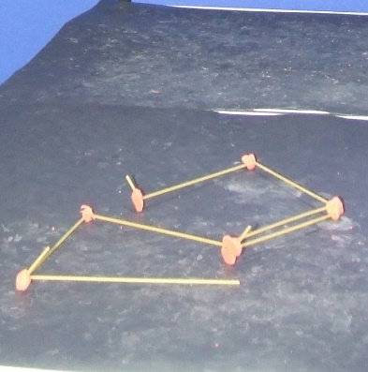
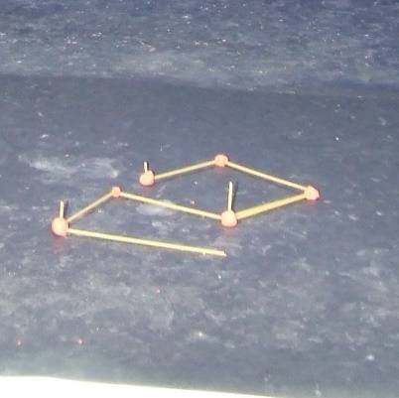
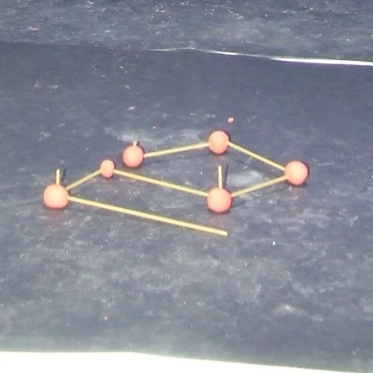
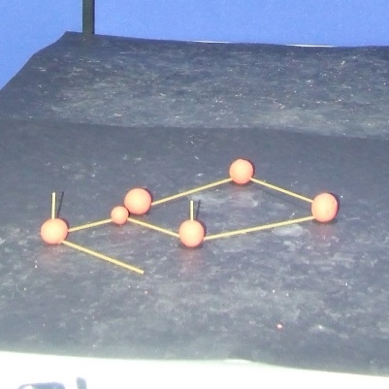
Seed structure:
Transmission chain (copying preceding structure)
G1 G2 G3 G4 G5

Slide 19
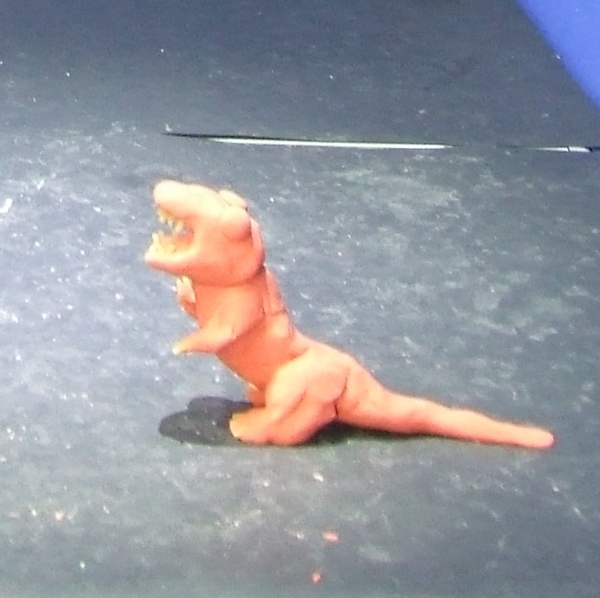
Seed structure:

Slide 20
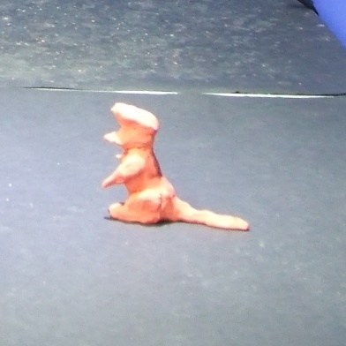
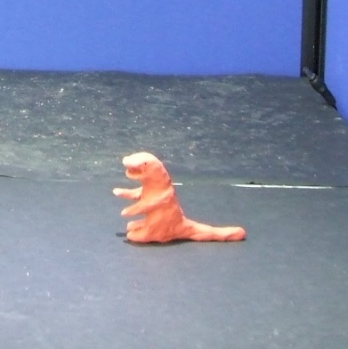
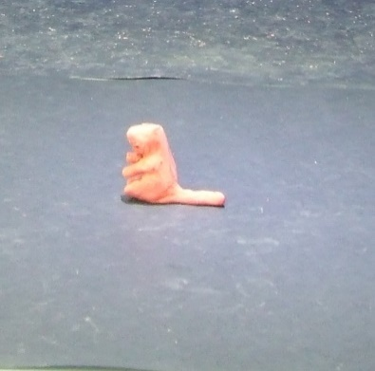

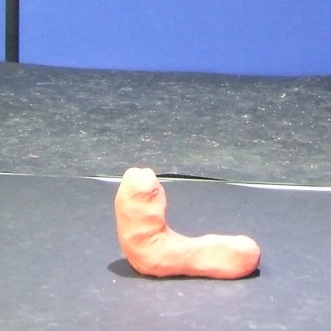
Seed structure:
Transmission chain (copying preceding structure)
G1 G2 G3 G4 G5

Slide 21
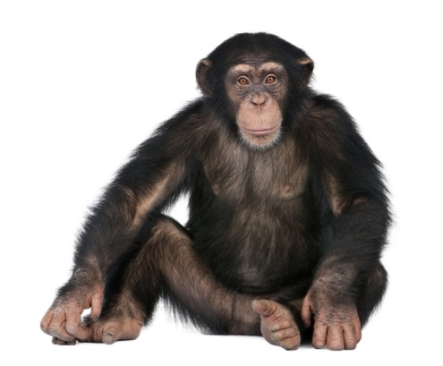

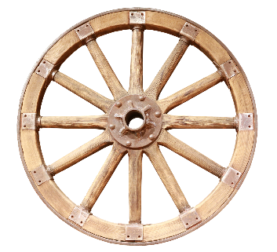


Experimental Approaches to Studying Cumulative Culture
Theoretical motivations
Practical motivations?

Slide 22
Capturing the Process
Boyd and Richerson (1995) demonstrated the adaptive value of cultural transmission that allowed “learned improvements to accumulate from one generation to the next”.
“For a given amount of time and effort, the better an individual’s initial guess, the better on average its final performance … [A]n imitator can … start its search closer to optimal behavior, and for a given amount of searching, it will achieve a better adult phenotype.” (p133)

Slide 23
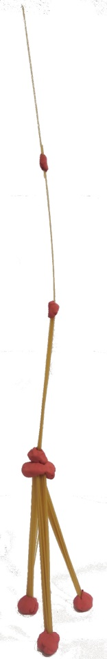
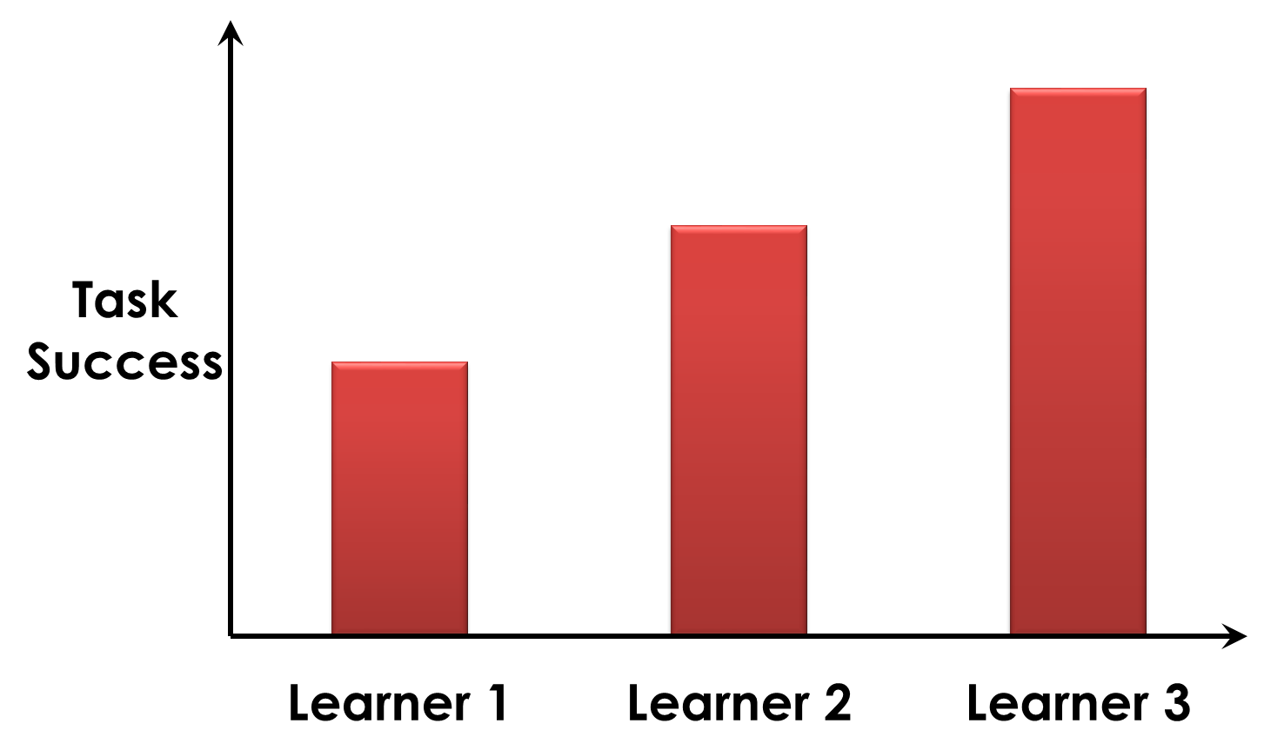
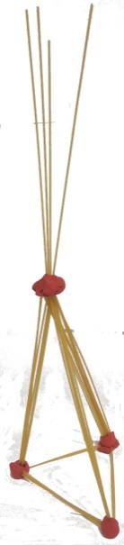
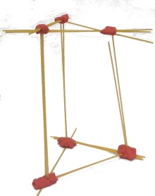
Operationalising cumulative culture
(e.g. Caldwell & Millen, 2008, Evol Hum Behav)
Success must increase with transmission

Slide 24
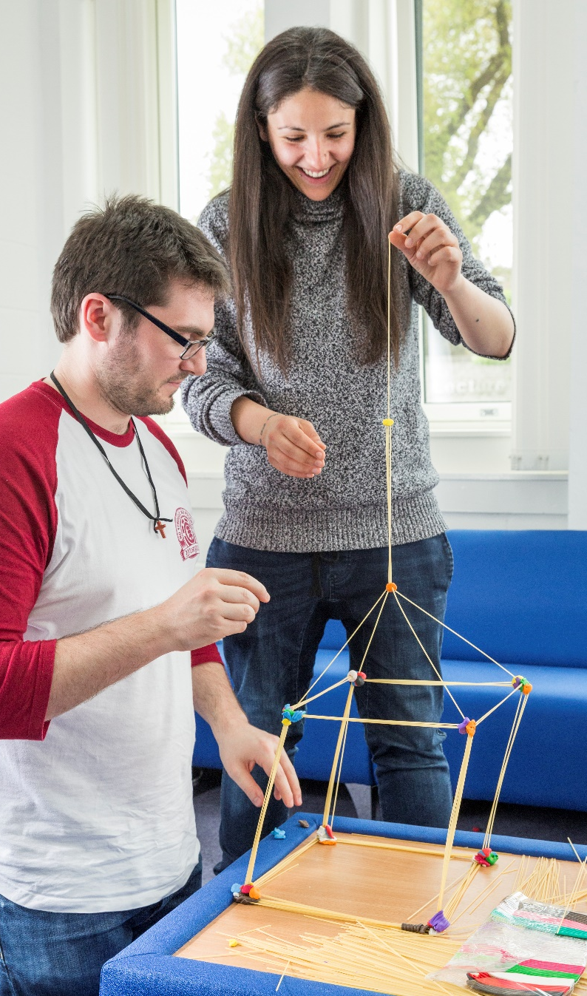
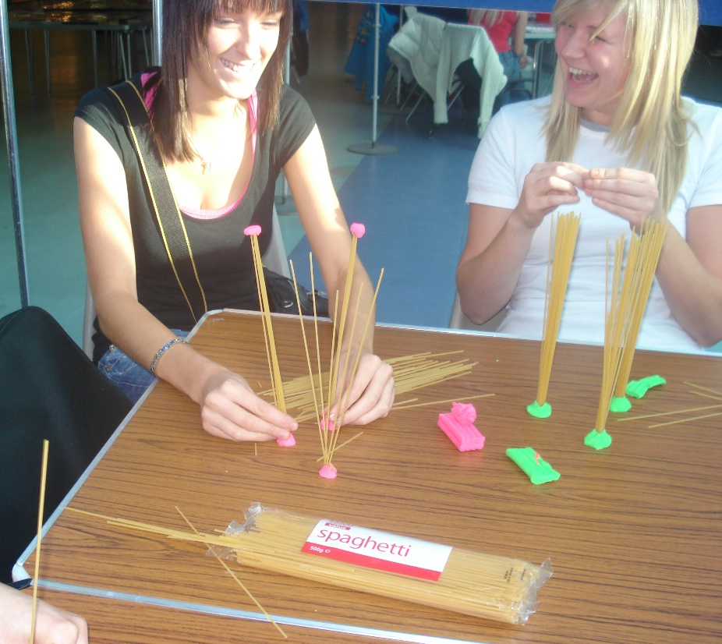

Slide 25
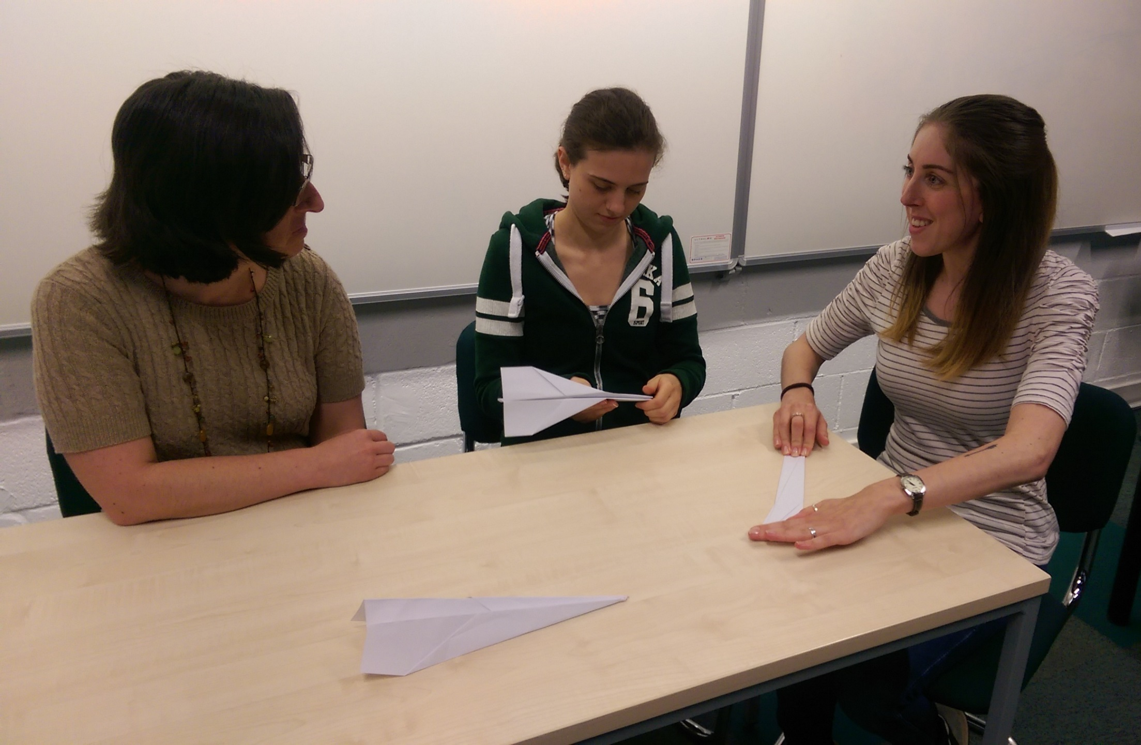

Slide 26


Dr Ailsa Millen
Caldwell & Millen (2008) Evol Hum Behav
Notes:
Two tasks – paper aeroplanes and spaghetti towers. Requires a goal measure that can be objectively measured. Goal measures were flight distance of the planes, and height of the spaghetti towers.
What was interesting about this is that it illustrates a learning-like effect of improvement with repeated attempts. However, each attempt is being made by a different individual. And each individual has the same amount of time available to them, and the same amount of time in the test group (so even the same amount of time to learn from the earlier members of the chain), but participants in the later generations perform better in terms of the goal measures of flight distance and tower height.
So this provides us with a scaled-down model of cumulative cultural evolution, since the later participants are able to perform much better, in the same experimental “lifetime”, so to speak, compared with those who took part earlier in the chain.
So this provided us with our laboratory model of cumulative culture, and this allowed us to experimentally manipulate the information that participants had access to.

Slide 27

Participant Number
1 | 2 | 3 | 4 | 5 | 6 | 7 | 8 | 9 | 10
up to
five minutes observation time followed by five minutes build time per participant
Notes:
Two tasks – paper aeroplanes and spaghetti towers. Requires a goal measure that can be objectively measured. Goal measures were flight distance of the planes, and height of the spaghetti towers.
What was interesting about this is that it illustrates a learning-like effect of improvement with repeated attempts. However, each attempt is being made by a different individual. And each individual has the same amount of time available to them, and the same amount of time in the test group (so even the same amount of time to learn from the earlier members of the chain), but participants in the later generations perform better in terms of the goal measures of flight distance and tower height.
So this provides us with a scaled-down model of cumulative cultural evolution, since the later participants are able to perform much better, in the same experimental “lifetime”, so to speak, compared with those who took part earlier in the chain.
So this provided us with our laboratory model of cumulative culture, and this allowed us to experimentally manipulate the information that participants had access to.

Slide 28
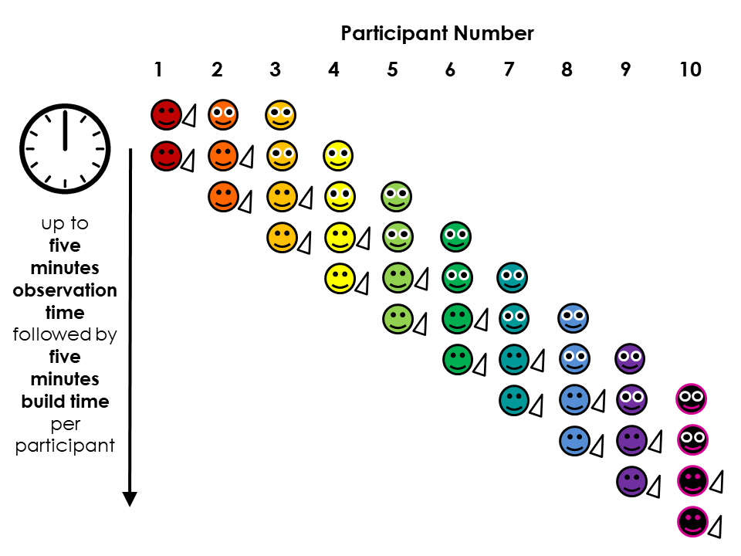

Slide 29
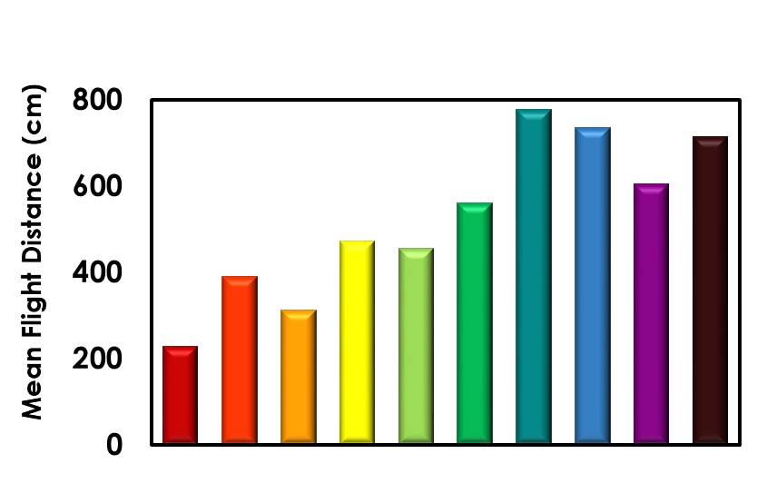

Slide 31
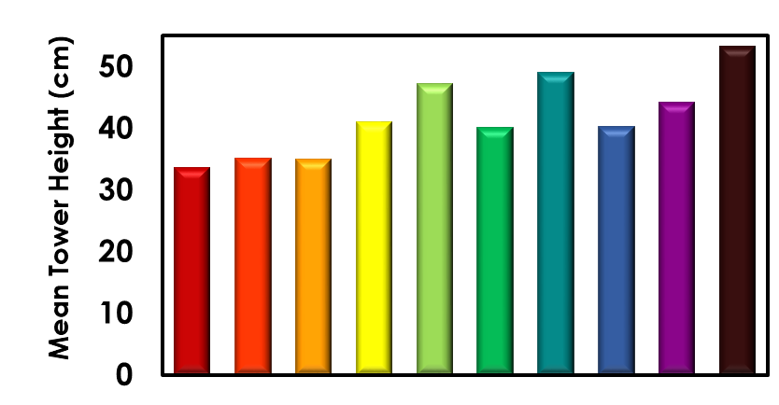

Slide 32
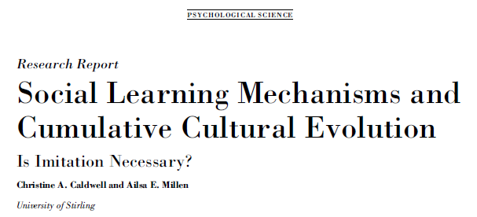

Slide 33
“Human cultural traditions can and do accumulate modifications over time, thus producing improbable design that survives over multiple generations… [H]uman social learners focus to a much greater degree than other non-human primates on the actual actions performed by others (process copying), not just the results produced on the environment (product copying).” (Tennie et al., 2009)
“cumulative cultural evolution depends on imitative learning, and perhaps active instruction on the part of adults, and cannot be brought about by means of “weaker” forms of social learning such as local enhancement, emulation learning” (Tomasello, 1999)

Slide 34
Social information available from:
A – Actions
R – Results
T – Teaching
Caldwell & Millen (2009) Psych Sci

Slide 35
Imitation and teaching not necessary for cumulative culture…

Slide 36
Imitation and teaching not necessary for cumulative culture…
…which is not the same as saying they are not important, or that they are never needed.

Slide 37
Other studies illustrate that process copying can facilitate cumulative cultural learning…

Slide 38
It is even possible to experimentally manipulate the trait variables to test predictions about the context-specificity of transmission requirements.

Slide 39

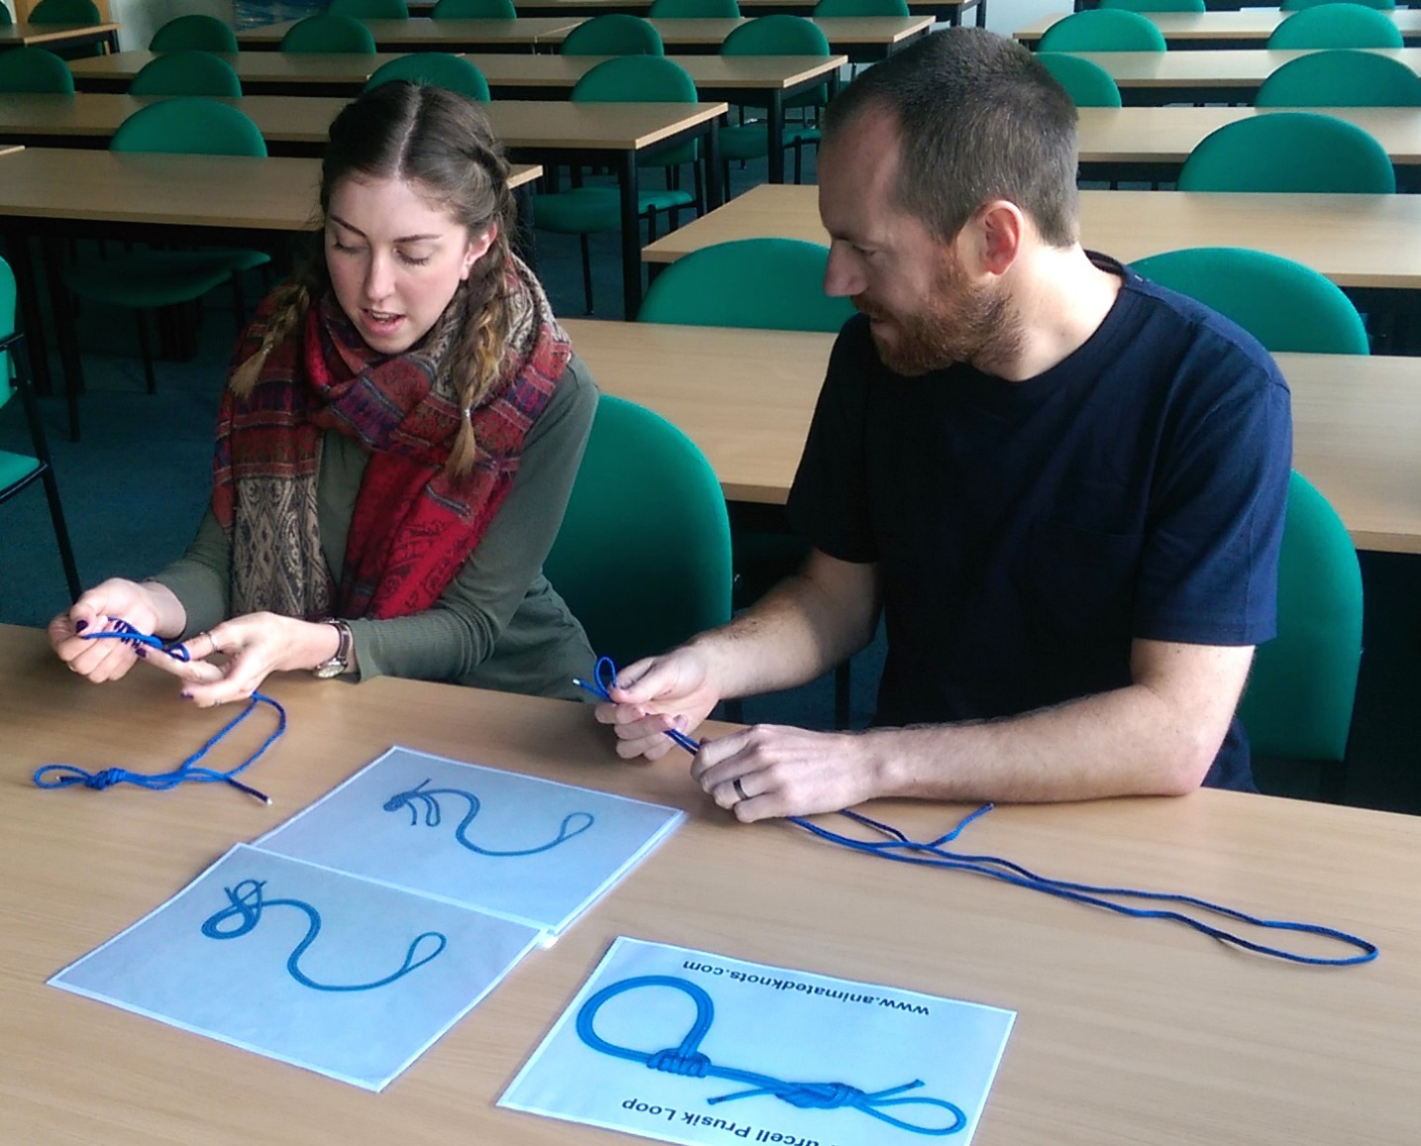
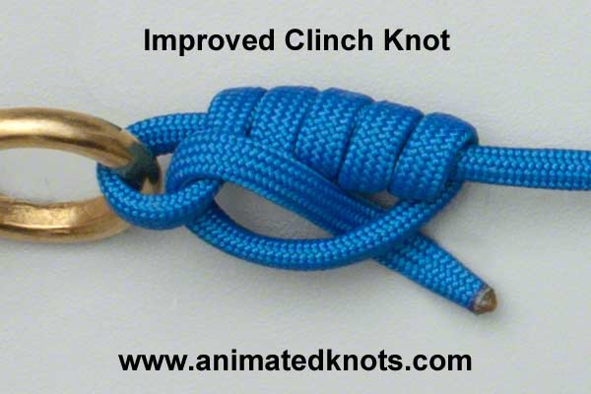

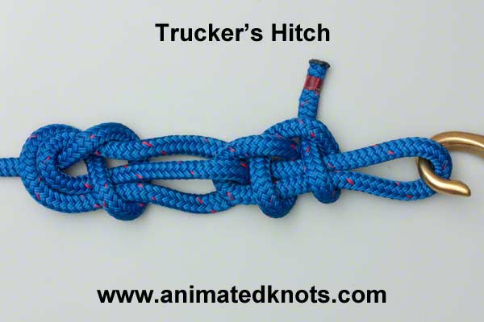
Caldwell et al. (2017) Rev Phil Psych

Slide 40
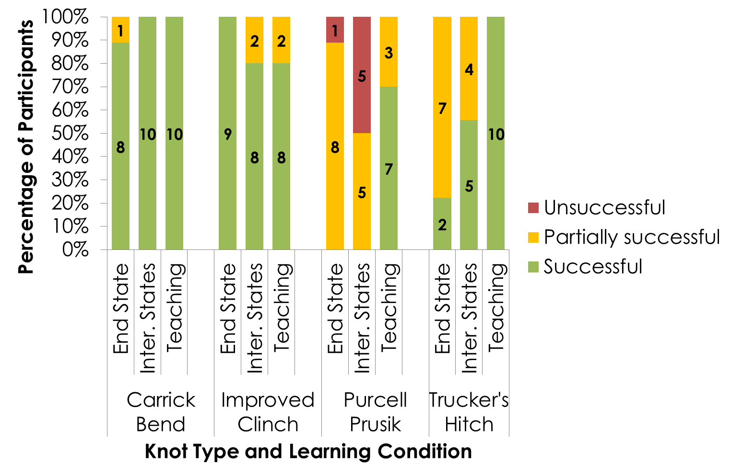

Caldwell et al. (2017) Rev Phil Psych

Slide 41
Caldwell et al. (2017) Rev Phil Psych

Slide 42
Caldwell et al. (2017) Rev Phil Psych

Slide 43

Caldwell et al. (2017) Rev Phil Psych

Slide 44
Conclusions
Experimental approaches on cumulative culture have now contributed significantly to basic understanding of this phenomenon.
Manipulation of learning conditions permits insights into the conditions favouring effective transmission and the accumulation of beneficial modifications.
Such approaches also have great potential to inform effective practice in a wide range of contexts.
Thinking and experimenting at the cultural population-level can bring novel insights about how best to achieve collective goals, and capitalise on existing knowledge.

Slide 45


Acknowledgements
Lab members (current):
  Dr Mark Atkinson, Kirsten Blakey, Juliet Dunstone,
  Donna Kean, Gemma Mackintosh, Dr Elizabeth Renner, Charlotte Wilks
Lab members (past):
  Dr Cara Evans, Roland Eve, Cristina Matthews,
  Dr Ailsa Millen, Dr Eoin O’Sullivan, Dr Gareth Roberts,
  Dr Kerstin Schillinger, Dr Claire Watson
Funding:
  ESRC Research Grants:
    RES-061-23-0072
    RES-062-23-1634
  ERC Consolidator Grant 648841 RATCHETCOG

